Slide 1



Cloud Computing &
Artificial Intelligence
Understanding the technologies shaping our digital future
Notes:
1

Slide 2
What We'll Explore Today
01
02
Cloud Computing Fundamentals
AI, ML & Deep Learning
Learn the key differences between these interconnected technologies
Discover how cloud services work and why they're essential for modern businesses
04
03
Interactive Discussion
Real-World Applications
Explore AI systems you interact with every single day
Analyse practical use cases to strengthen your understanding
Notes:
2

Slide 3
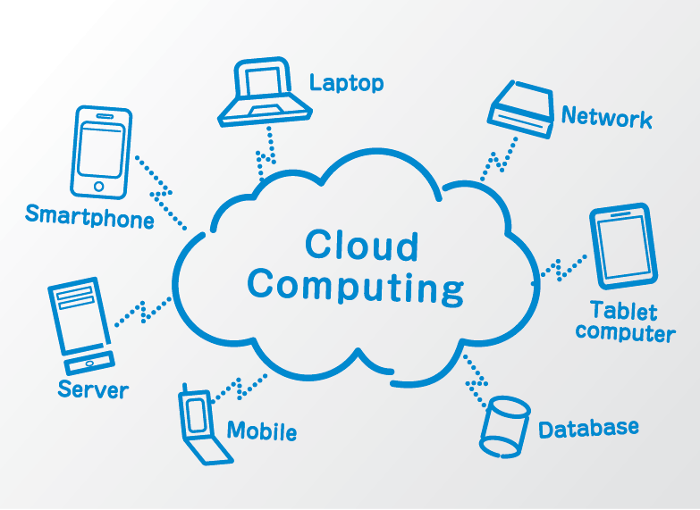
What is Cloud Computing?
Cloud computing delivers computing services—including storage, processing power, and applications—over the internet. Instead of owning physical servers or data centres, organisations rent access to these resources from cloud providers like Amazon Web Services, Microsoft Azure, or Google Cloud.
This approach offers flexibility, scalability, and cost savings. Businesses can quickly expand their digital infrastructure without massive upfront investments in hardware.
Notes:
3

Slide 4
The Three Cloud Service Models
IaaS
PaaS
SaaS
Infrastructure as a Service
Platform as a Service
Software as a Service
Provides virtualised computing resources over the internet. You rent servers, storage, and networking equipment whilst managing the operating system and applications yourself.
Offers a complete development environment in the cloud. Developers can build, test, and deploy applications without worrying about underlying infrastructure management.
Delivers fully functional applications over the internet. Users access software through a web browser without installation or maintenance concerns.
Notes:
4

Slide 5

Why Businesses Embrace Cloud Solutions
Cost Efficiency
Pay only for resources you use, eliminating expensive hardware purchases and maintenance costs
Scalability
Instantly increase or decrease capacity based on demand without physical limitations
Accessibility
Access data and applications from anywhere with an internet connection, enabling remote work
Automatic Updates
Cloud providers handle software updates and security patches automatically
Notes:
5

Slide 6
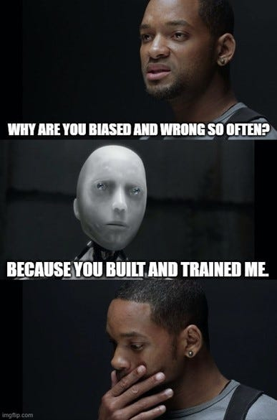
Understanding Artificial Intelligence
Artificial Intelligence refers to computer systems designed to perform tasks that typically require human intelligence—such as visual perception, speech recognition, decision-making, and language translation. AI systems learn from experience, adapt to new inputs, and can accomplish human-like tasks with increasing sophistication.
Notes:
6

Slide 7

AI, Machine Learning & Deep Learning
These terms are often used interchangeably, but they represent distinct concepts with specific relationships.
Deep Learning
Machine Learning
A subset of ML using neural networks with multiple layers to process complex patterns
Artificial Intelligence
A subset of AI where systems learn from data without explicit programming
The broadest concept—any technique enabling computers to mimic human intelligence
Example: Image recognition, voice assistants
Example: Email spam filters that improve over time
Example: Chess-playing programmes, chatbots
Notes:
7

Slide 8

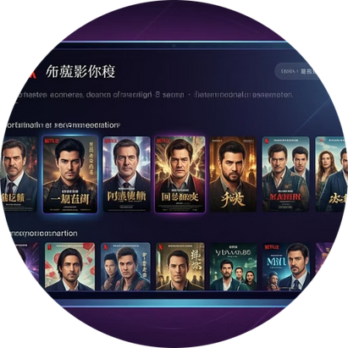

AI in Your Daily Life
Voice Assistants
Recommendation Systems
Facial Recognition
Siri, Alexa, and Google Assistant use natural language processing to understand and respond to your spoken commands
Your smartphone uses AI to identify your face for secure unlocking and photo organisation
Netflix, Spotify, and Amazon analyse your preferences to suggest content you'll likely enjoy
Notes:
8

Slide 9
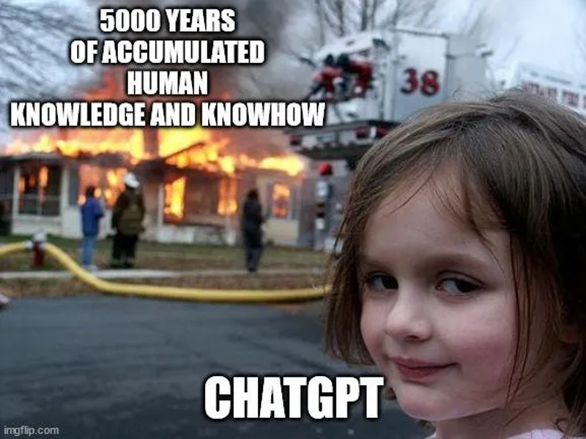
Analysing Real-World AI Use Cases
Let's strengthen our understanding by examining how AI solves real problems. Consider these scenarios and identify which type of AI technology is being used.
Scenario 1
Scenario 2
A hospital uses AI to analyse X-ray images and detect early signs of diseases
Your email automatically sorts messages into primary, social, and promotional categories
Scenario 3
A self-driving car recognises traffic signals, pedestrians, and other vehicles in real-time
Notes:
9

Slide 10
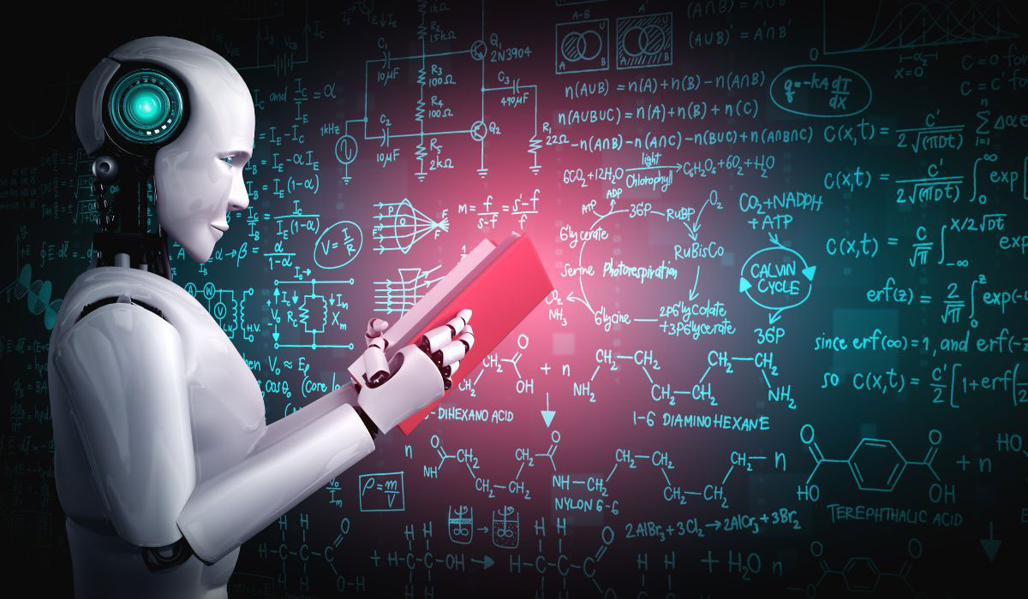
Key Takeaways
1
2
Cloud Computing Transforms Business
AI is a Layered Concept
Artificial Intelligence encompasses Machine Learning, which includes Deep Learning—each building upon the previous layer
IaaS, PaaS, and SaaS models provide flexible, scalable, and cost-effective solutions for storing data and deploying applications
3
AI is Already Here
From voice assistants to recommendation systems, AI technologies are seamlessly integrated into the tools you use every day
Notes:
10

